Slide 1
Module 5: Machine Learning Tools For Materials Science
Acknowledge to Ben Afflerbach and Dane Morgan

Slide 2
Materials Databases
ASM: alloys
Materials Project: computationally calculated properties
Materials Data Facility: comprehensive database
PubChem: chemical information
Citrination: comprehensive database; integrated into ML workflow
Notes:
Outside of a lab environment where you have the ability to generate your own data, the most common way to obtain data would be to search publically available databases
Among the 5 examples here each of them are tailored towards certain classes of materials or types of data. See notes below.
ASM: alloys
Materials Project: computationally calculated properties
Materials Data Facility: comprehensive database
PubChem: chemical information
Citrination: comprehensive database; integrated into ML workflow

Slide 3
Typical Language – Python
Free, widely used, many libraries and existing code for what you need (numerical libraries, data types, plotting, ML routines, etc.). For example, some basic Python Data Science Tools are:
Standard notebook to organize python code – see lab.
NumPy: scientific computing
(e.g. multidimensional arrays)
Pandas: data manipulation and analysis
Matplotlib: data visualization
People also use Matlab, R, …
Notes:
- These tools (and many more) give you incredible control over your data. And they are already built for you. Can do all parts seperately
- What’s shown here is merely the tip of the iceberg. If you need to accomplish something, chances are there’re already tools built for it, so make good use of existing tools.
- While it is essential to become comfortable using these tools, mastery takes time and isn’t a focus of this curriculum.
- However, you will get a chance to see these tools in action in the accompanying lab activity (if lab activity is used in conjunction with this module).
NumPy: scientific computing (e.g. multidimensional arrays)
Pandas: data manipulation and analysis
Matplotlib: data visualization

Slide 4

A Few Basic Python-Based Machine Learning Tools
Good for deep neural networks
Good for almost all ML
Good for deep neural networks
Scikit-learn can implement a wide variety of models, but doesn’t cover neural networks beyond simple configurations
Tensorflow/Keras are targeted more specifically towards building neural network type models
Notes:
These next few tools implement machine learning algorithms and steps from the workflow.
For example there is a specific module within the scikit-learn package that can run a number of different cross validation routines
Scikit-learn can implement a wide variety of models, but doesn’t cover neural networks beyond simple configurations
Tensorflow/Keras are targeted more specifically towards building neural network type models

Slide 5
Python-Based Materials Specific Machine Learning Tools
full Supervised Learning workflow
featurization
Two packages that enable a full end to end workflow and MASTML and Citrine Informatics “Citrination” platform.
Both enable users to start with a dataset of compositions and target values and get back a full output of trained models with validation on performance.
There are also several packages that are focused on materials specific featurization. Remember that generating features is a key step in the workflow, and these allow material compositions to be transformed into feature vectors that can be used by ML models.
Notes:
Two packages that enable a full end to end workflow and MASTML and Citrine Informatics “Citrination” platform. Both enable users to start with a dataset of compositions and target values and get back a full output of trained models with validation on performance.
There are also several packages that are focused on materials specific featurization. Remember that generating features is a key step in the workflow, and these allow material compositions to be transformed into feature vectors that can be used by ML models.
Citrination and MASTML take advantage of these strategies in their workflows.

Slide 6
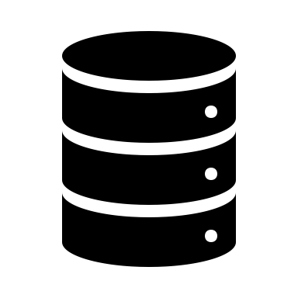

Hardware for Machine Learning – Much is Free!
Laptop | GPUs / TPUs
Small datasets | Large datasets (e.g. image recognition)
Free | There are free ways to get access (e.g., Google CoLab, NanoHub)
Depending on dataset size, many aspects of ML can be performed locally on your laptop!
However, if running into run time issues there are many cheap to free solutions to getting more computing power.
Key takeaway is that computing power should not be a limiting factor
Notes:
Depending on dataset size, many aspects of ML can be performed locally on your laptop!
However, if running into run time issues there are many cheap to free solutions to getting more computing power.
Key takeaway is that computing power should not be a limiting factor, don’t let it dissuade you!

Slide 7
Summary
There are a multitude of tools available to perform various aspects of machine learning. Unless you are at the cutting edge of development, there is probably a tool out there to do whatever you’re trying to do! Don’t re-invent the wheel!
These tools are often free and can be run remotely! Computational power is probably not a limiting factor!

